Slide 1
Student Management Data Analysis(SQl Project)
By Mo Yasir

Slide 2

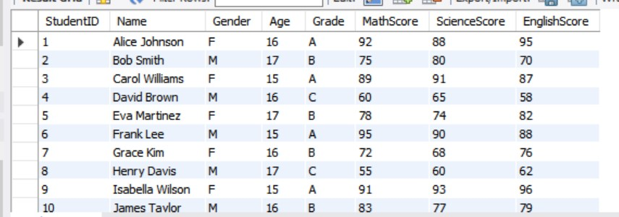
Query 1: Show All Student Details

Slide 3
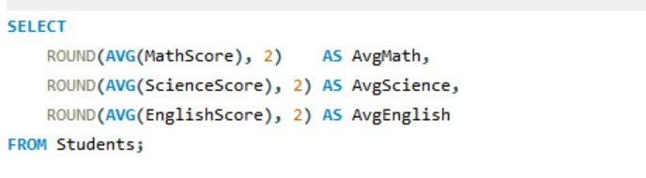

Query 2: Average Score in Each Subject

Slide 4
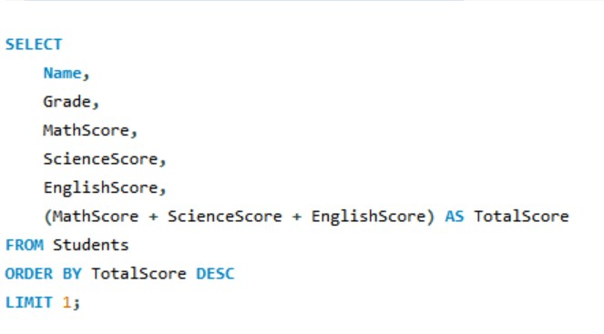
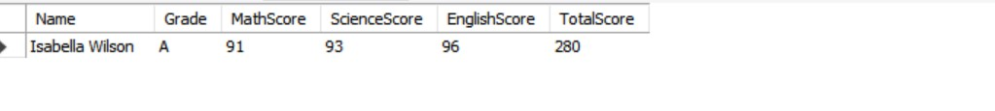
Query 3: Top Performer (Highest Total Score)

Slide 5
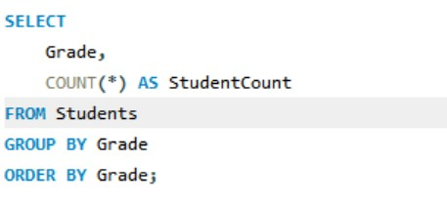
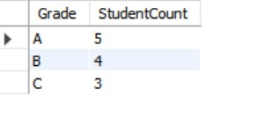
Query 4: Count Students Per Grade

Slide 6
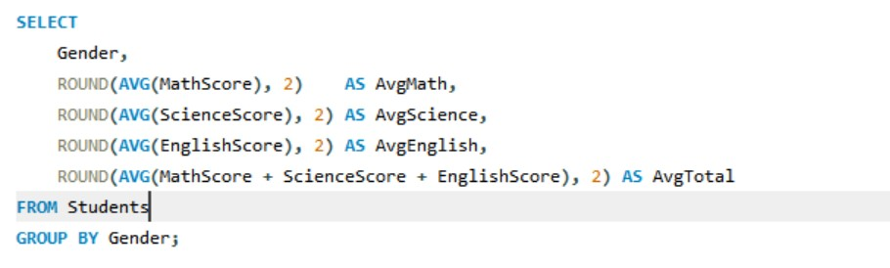
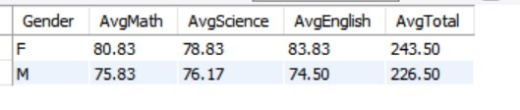
Query 5: Average Score by Gender

Slide 7
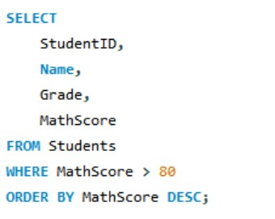
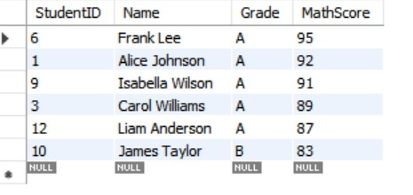
Query 6: Students with MathScore > 80

Slide 8
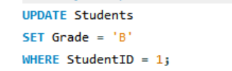
Query 7: Update a Student's Grade

